Slide 1
Parse Trees
By Kurt Jensen

Slide 2
About parse trees
Parse trees illustrate how a specific string fits to a syntax diagram. The parse tree begins with a nonterminal expression at the very tip of the tree, and branches into progressively simpler expressions until the entire statement is represented as a series of terminal expressions.
Parsing
A transformation from a sequence to a tree

Slide 3
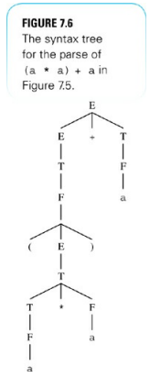
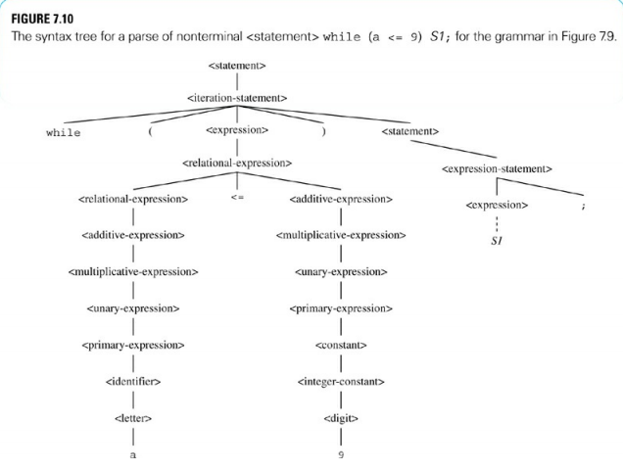

Slide 4
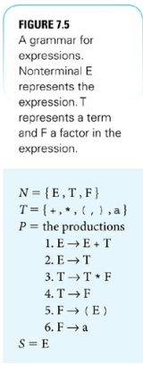
grammar
A grammar is a system that specifies how you can concatenate (link together in a chain or series) the character of alphabet T to form a legal string in a language.
Formally, a grammar contains 4 parts:
N, a nonterminal alphabet.
T, a terminal alphabet.
P, a set of rules of production.
S, the start symbol, which is an element of N.

Slide 5
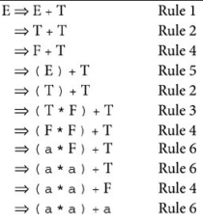
A grammar that describes an expression

Slide 6
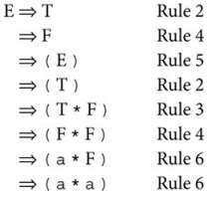
Here is an example when someone uses a rule at the wrong time. The results that he came to were (a*a) rather then (a*a)+a. This is because he used rule number 2 rather than rule number 1 at the start.

Slide 7
Do you see the issue?

Slide 8
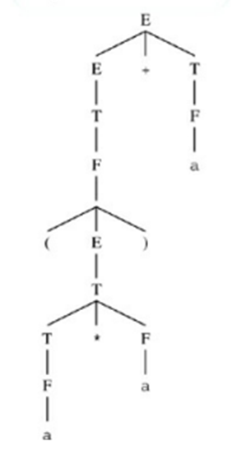
Converting to trees

Slide 9
Practice
Draw the corresponding syntax tree:
a+(a)
a*(a+a)
(((a)))

Slide 10
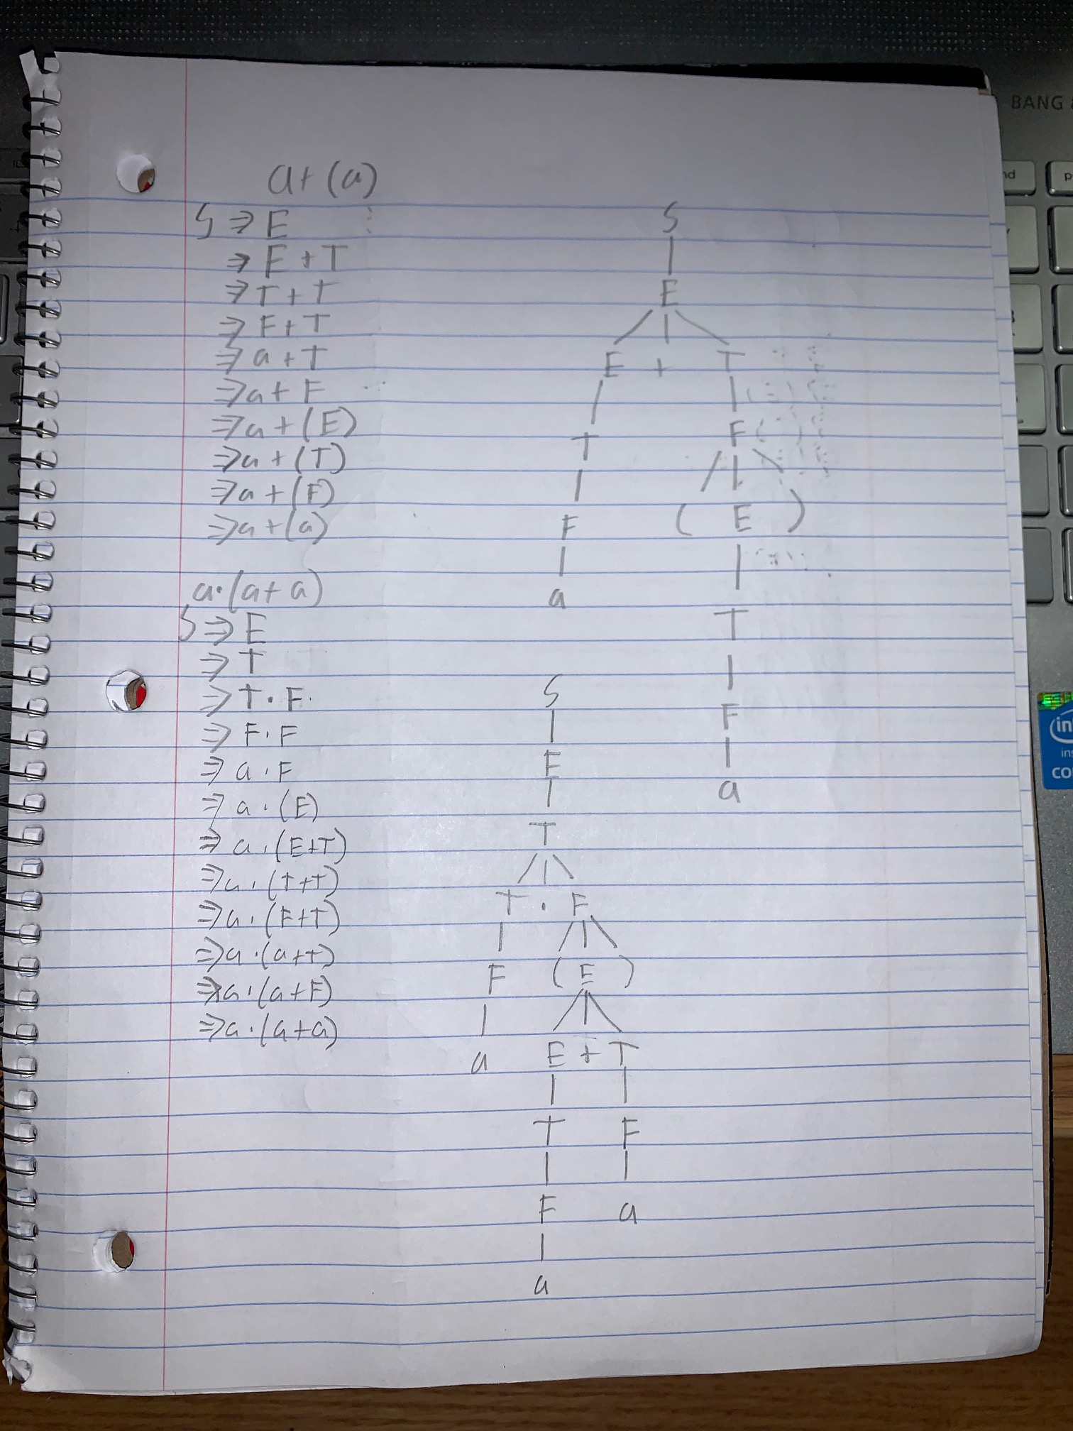
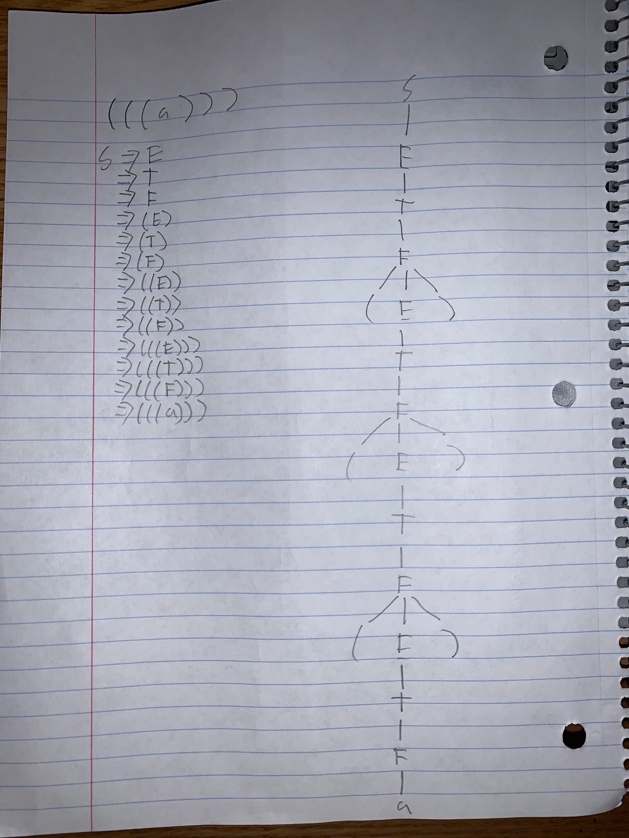
Answers

Slide 11
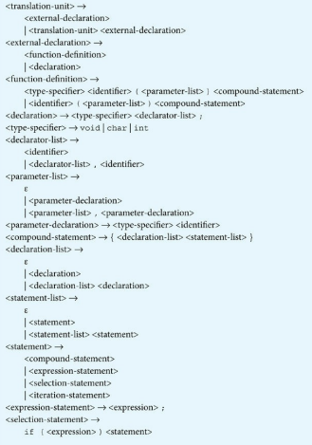
Eventually it’ll turn into a more complicated parsing tree
A grammar for a subset of the C language

Slide 12
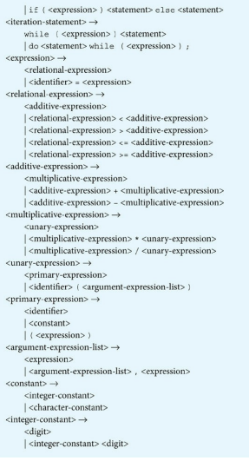
Eventually it’ll turn into a more complicated parsing tree
A grammar for a subset of the C language cont.

Slide 13
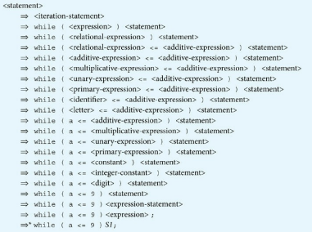
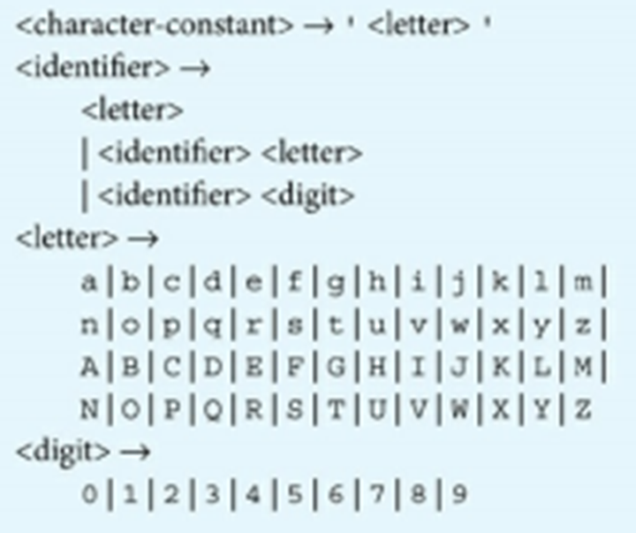
Eventually it’ll turn into a more complicated parsing tree
A grammar for a subset of the C language cont.
The derivation of nonterminal <statement> while(a<=9)S1;

Slide 14
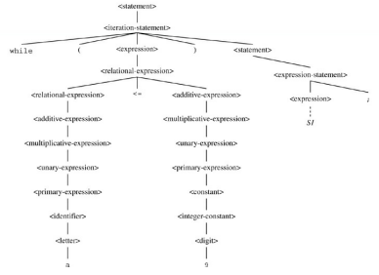
Eventually it’ll turn into a more complicated parsing tree
Parse Tree

Slide 15
References
Warford, J., 2017. Computer systems. 5th ed. Burlington: Jones & Bartlett Learning, pp.395-407.

